Slide 1

Unified Mentor, Gurugram, Haryana
Dissertation Project Report
On
Google Play Store App Rating Prediction
Presented by:
Swapnil Prabhakar Chavan

Slide 2
Introduction
Objective: Analyze Google Play Store dataset to discover app trends, pricing effects, and factors affecting ratings & installs.
Why important: Helps app developers & marketers improve app visibility and user satisfaction.
Dataset contains both free & paid apps across multiple categories.

Slide 3
Dataset Overview
Source: googleplaystore.csv
Total apps: ~10,000+
Key columns: Name, Category, Rating, Reviews, Size, Installs, Type, Price, Last Updated
Missing values in ratings, size, and price handled

Slide 4
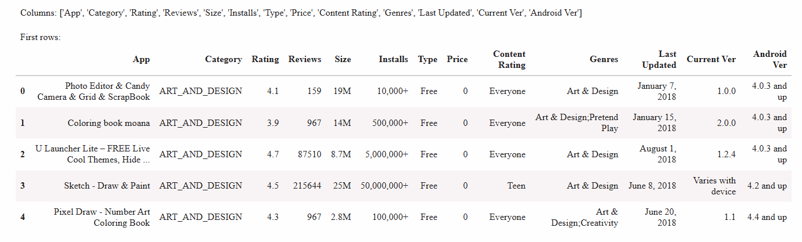

Slide 5




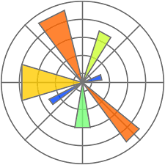

Tools & Libraries
Tools:
Python 3 with Jupyter Notebook
Libraries:
Pandas – Used for data cleaning & manipulation
Numpy – Used for numerical calculations
Matplotlib – Used for plotting and graphs
Seaborn – Used for advanced data visualization

Slide 6
Data Cleaning Steps
Removed duplicates
Converted numeric fields: Reviews, Installs, Price, Size
Parsed Last Updated → Date & App Age
Imputed missing ratings by category median
Created Price Bucket, Size Bucket, Rating Group

Slide 7
Feature Engineering
Price Bucket: Free, Cheap, Mid, Premium
Size Bucket: Small, Medium, Large
Rating Group: Low, Medium, High
App Age (days): Time since last update
Installs per MB: Efficiency metric

Slide 8
App Count by Price Bucket
Majority of apps are free (~90%)
Few premium apps (> $20)
Cheap apps dominate paid segment

Slide 9
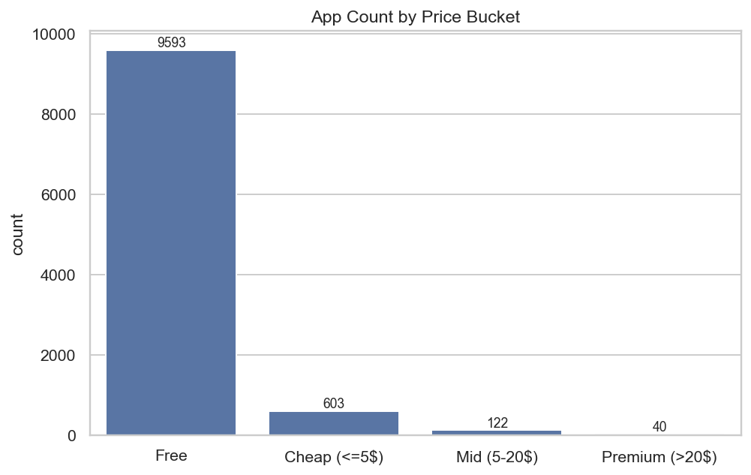

Slide 10
Average Rating by Size Category
Small (<10MB) & Medium (10–50MB) apps have slightly higher ratings than large apps
Possible reason: smaller apps run on more devices, better user reach

Slide 11
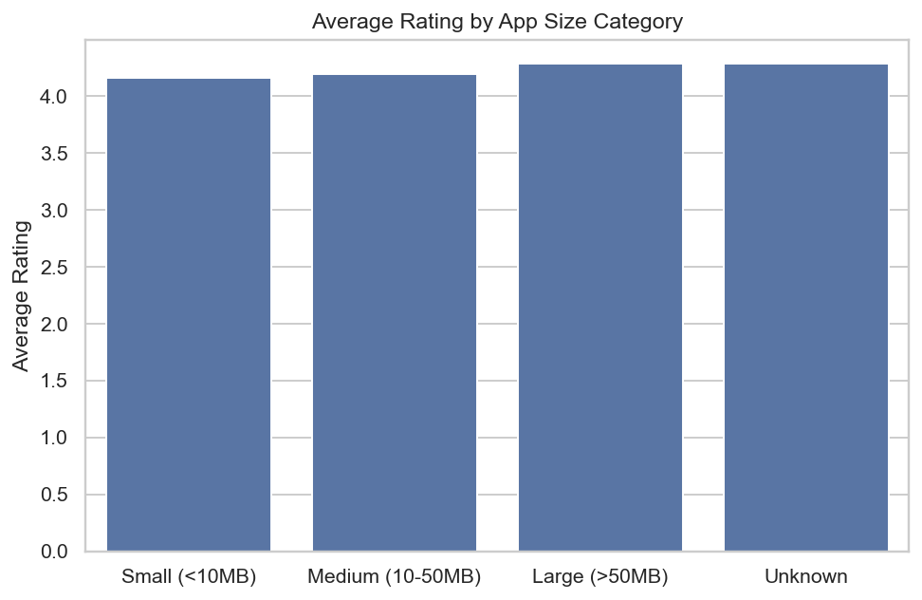

Slide 12
Installs by Rating Group
High-rated apps (≥4) have significantly more installs
Low-rated apps have limited reach

Slide 13
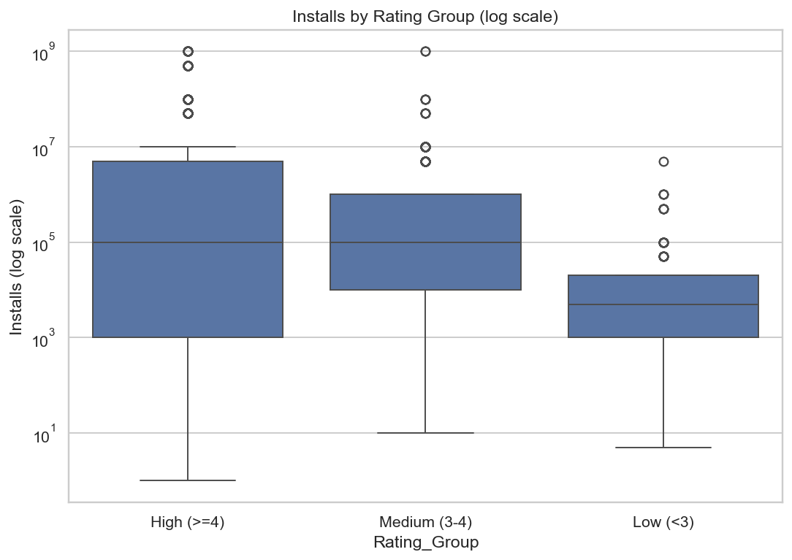

Slide 14
Top 10 Categories by Average Installs
Game, Communication, and Social apps dominate install counts
Utility apps have lower but consistent installs

Slide 15
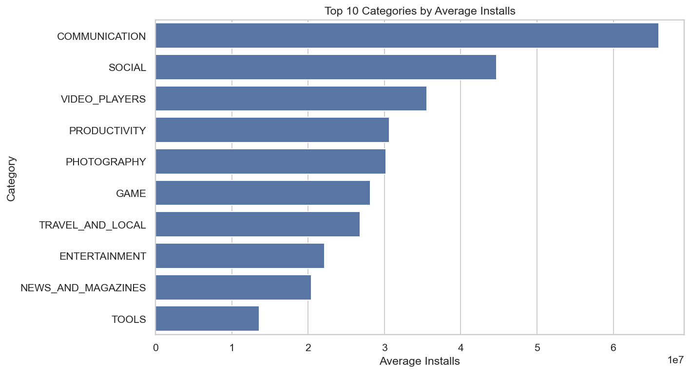

Slide 16
Apps Updated per Year
Peaks in recent years — indicates active development
Some old apps remain un-updated for long

Slide 17
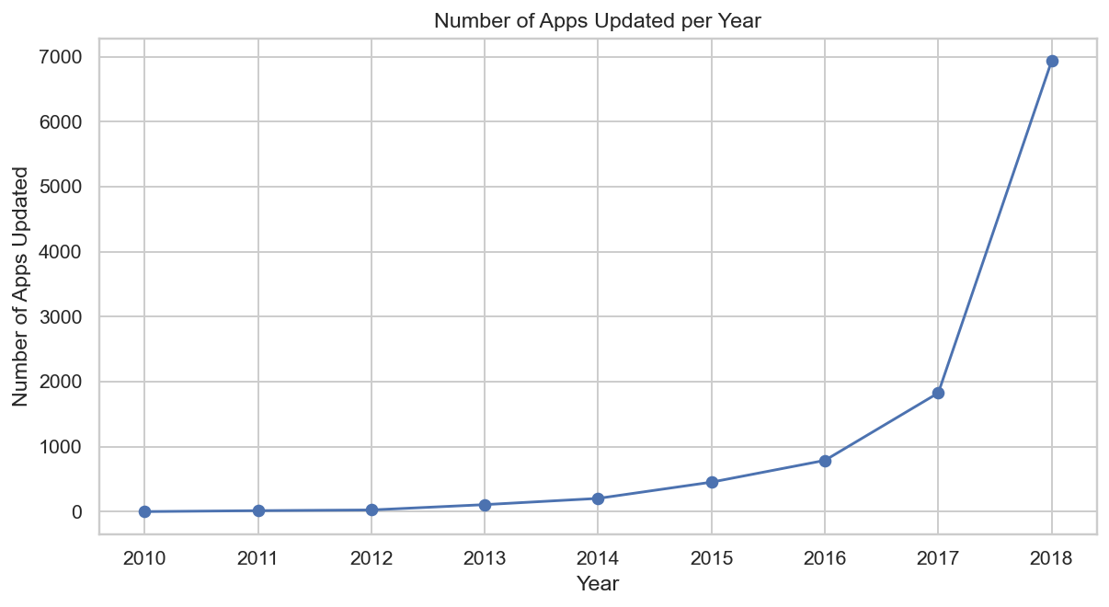

Slide 18
App Age vs Rating
Slight negative correlation: older apps tend to have lower ratings
Frequent updates may boost ratings

Slide 19
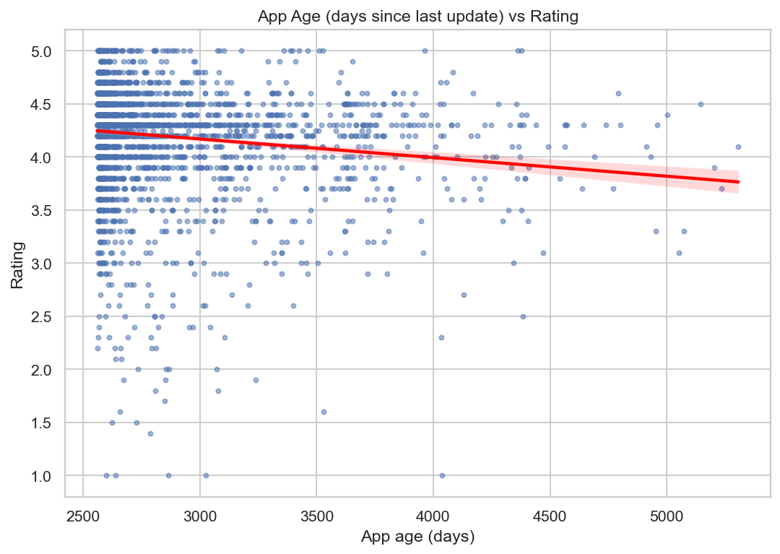

Slide 20
Paid Apps: Price vs Installs
Higher-priced apps have very low installs
Most paid apps cluster below $10

Slide 21
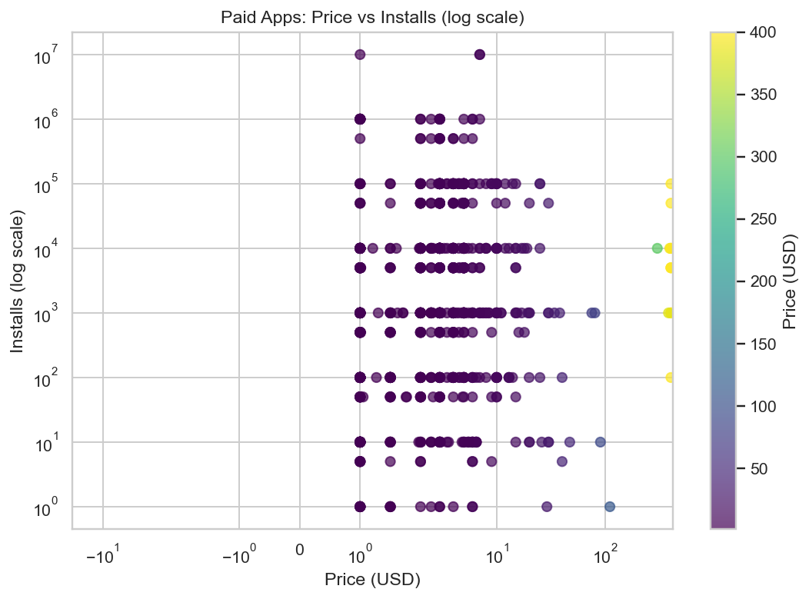

Slide 22
Installs per MB Distribution
Some apps achieve very high installs per MB (efficient)
Large inefficient apps may struggle with adoption

Slide 23
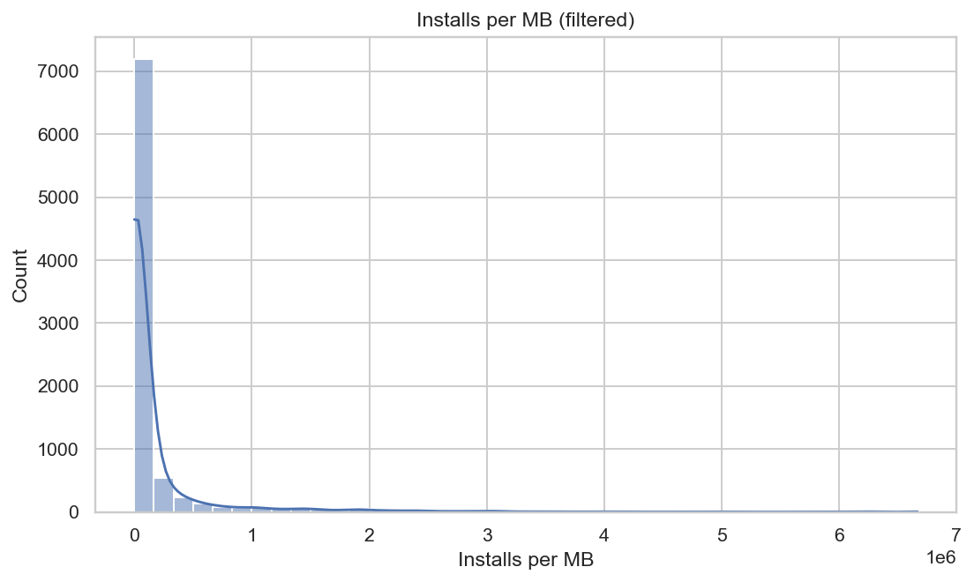

Slide 24
Numeric Correlation Heatmap
Reviews and Installs strongly correlated
Price has negative correlation with installs

Slide 25
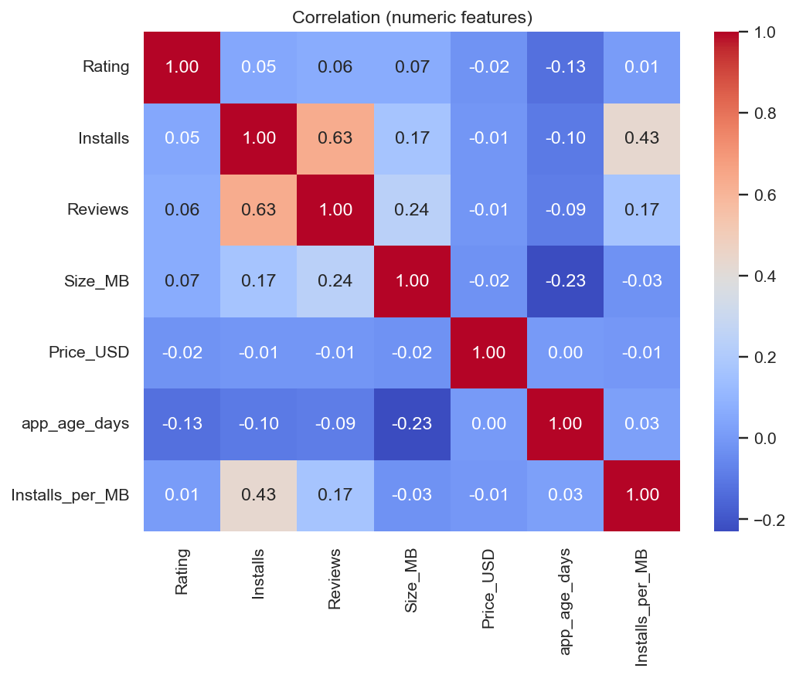

Slide 26
Conclusion & Recommendations
Developers should focus on user ratings & frequent updates
Consider app size optimization for wider reach
Paid apps should balance price & value

Slide 27
Thank you!

